Slide 1
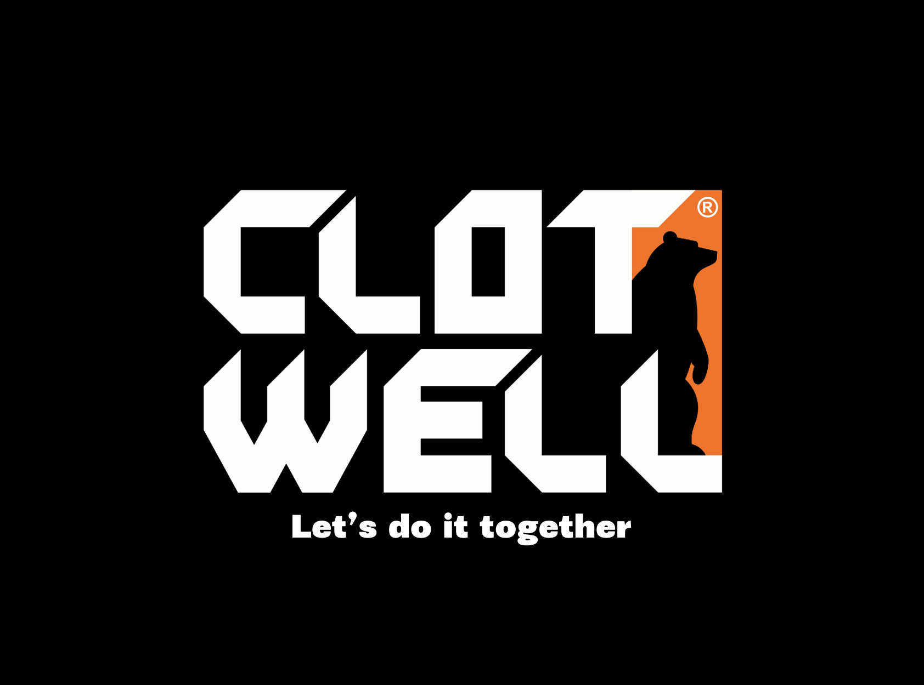

Slide 2
HERRITAGE
90-s…, there were almost nothing to find down here in ex USSR countries. After USSR disintegration in 1991 the founders Oleg and Valeriya have come to Kazakhstan. They lived simple life as everyone does. As you might know KZ is not very attractive market for big brands and even smaller ones. Kazakhstan always gets small attention to itself as these days it has small population and average salary rate.
Valeriya likes garments production so she has started sewing garments for her little son, using small different fabrics pieces which were at disposal. Their friends and environment have noticed that their son wears something uniq something that is not in the market. Family got their first orders from the friends been asking to make clothes for their children, this where they found their first success. As time passes Oleg and Valeriya receives orders, they were making dresses, both women’s and man’s suits, orders were usually given by their friends.
As there were nothing to buy in the market, founders found out that there is a niche to make garments. They have decided to make women’s suit and children’s overall in bulk. They did not have their own facilities to produce required quantity, and were no skills to make it on their own. It was a decision to sign subcontracts with already existed workshops. Unfortunately due to lack of an experienced workshops project was failed.
After a non successful experience Valeriya has found some nice tricot fabric and start to design garments by her own and successfully sold all items. This is where she afforded to buy a new overlock.
September 1995. No machines and own building, only dream and true love to their business. They came up with an idea to start up a workshop. Business was based on blankets filled with camel wool witch were made during 1995-1998 years.
1999 year. An idea to start doing workwear mass production, but there were still no specialists attracted to the company, only sewing operators. Speaking about our first samples, they were so unattractive with no technology and construction skills. Later they came to the point when they required a specialist. They have started to search a technologist and a constructor, knew nothing of who shall they look for, only asking and studying newspapers and books.
2001 a year of our company hired its first technologist.
2004 company bought own building .
2009 a year of the first military contract
2014 year our company has won Government contest as one of the perspective companies and reward was involved specialist of Canadian consultancy company CESO. Target of the session was to build the strategy of development for further 5 years.
2015 owners have decided to develop production area and build new facilities. Business plan has been prepared and offered for the consideration. The project was approved by KZ Government and company received investments for the building new facilities and purchasing of a brand new automatic equipment.
After a long work on a military and a workwear markets in 2016 founders start to think about own brand of active apparel and gear.
2017 Geiba Kaizen philosophy was implemented. It helps company to start its beautiful journey to achieve lean production system.
Later in 2018 CLOTWELL Ltd along with European bank for reconstruction and development has initialized project «senior advisors». Project has its attention to the production quality and new brand development. This project brought us more than we expected. Jan Gunnar Davidsson met his future DonCano manufacturers and international distributors.
2019 year we have signet agreement with Polartec and Westex - international leaders in textile industry

Slide 3
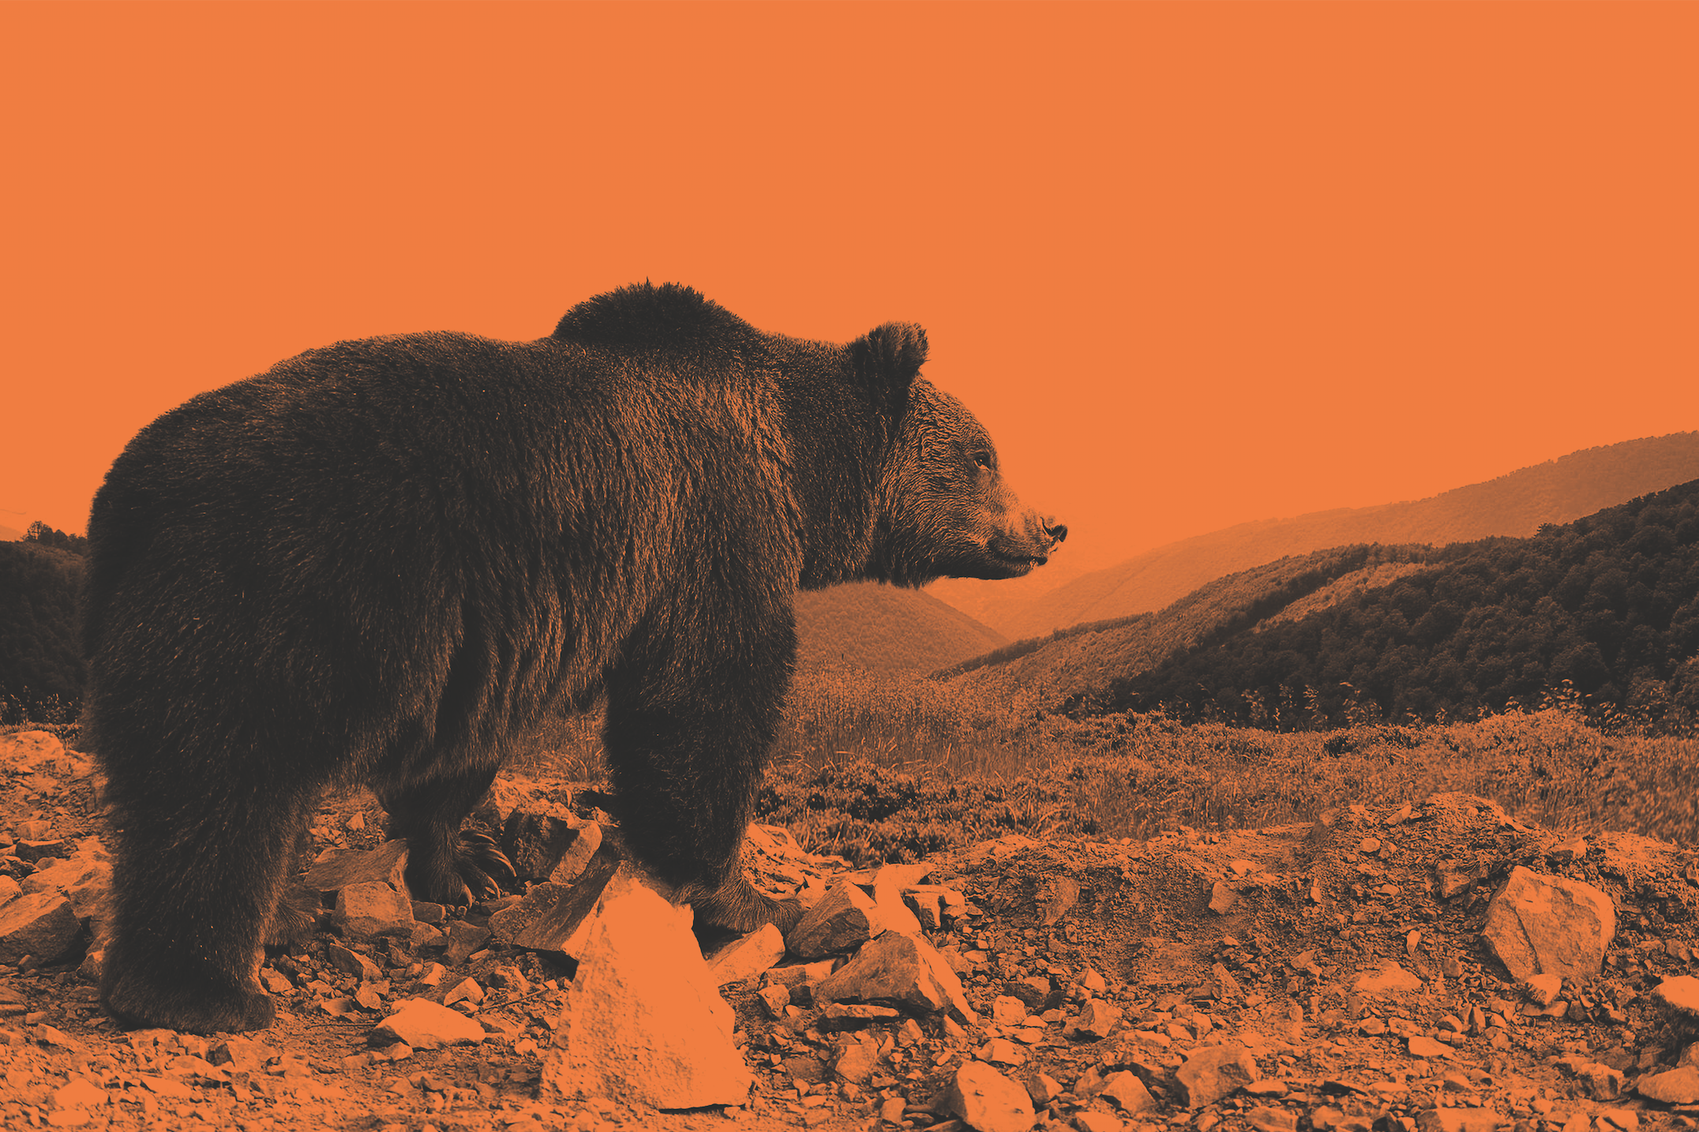
OUR MISSION
WE CAN CONQUER ANY CHALLENGE TOGETHER
Work in hard environment is challenging, so are free-time activities. No matter how hard you push, how high you climb – your goal is everything.
We are your partner to achieve these targets.
Our mission is to equip you for every possible challenge by providing you with garments and accessories for protection and enhancement of personal performance.
Let’s do it together.

Slide 4
WE ARE CLOTWELL
CLOTWELL’s core values we truly believe in and deliver to all our partners
Creativity
C
Our approach to business is to be Creative. Innovative elements in conjunction with the functional design would satisfy requests of our clients.
Loyalty
Our company stands on being a long term partner for you executing tasks in the most proper way.
L
O
T
Openness
We are opened for our partners. We try to build opened dialogues. Ready to present required information about our company.
Timeous
We truly understand time importance. The only thing in our life that is not under our control. We believe that being in time means to
Everything we do we do it WELL

Slide 5
GENERAL information
Since 1995. Rebranding in 2013 to «CLOTWELL»
Based in Kazakhstan
Production area: 3000 sq. Meters
Warehouse volume: 3000 cub.m
Stuff 100 + people
Current product lines: Military uniform, workwear, uniform for medical use

Slide 6
DEPARTMETNS
Department | Equipment and software
Design and development | Here we design and develop new items using the latest and advance systems in textile and garment area.
Construction | Highly skilled team on daily basis fits designed items to human bodies using Gemini CAD
Cutting area | Automatic workshop with the stuff of superior expertise in the cutting field shows the most efficient job
Sewing laboratory | Using the latest developments in the machinery industry we assemble designed garments adding notices if required.
Workshops | Mass production within 2 workshops. 156 people create value for the product you choose.

Slide 7
partners
European Bank for Reconstruction and development as a consultant supervisor in the field of company management optimization.
EU-projects. Dr. Mattila as a Senior consultant. Professor of the international textile university of Barosso, Sweden.
Jan Davidson as a design developer and the owner of DonCano brand.

Slide 8
KEY SUPPLIERS
POLARTEC. In 2018 CLOTWELL & Polartec have signed exclusive agreement allows CLOTWELL to use branded fabrics in the production of the functional wear. Polartec allows partners to use their knowledge base. Initially Polartec’s been making fabric for military use, after testing both in laboratories and field fabrics goes to the mass production. Polartec’s exclusivity is to present product line with high functionality, low weight, using the most advance technologies in textile industry.
WESTEX is one of the five biggest international manufacturers of the functional PPE fabrics. WESTEX products are used for military, firefighters, chemical, mining needs. In 2019 CLOTWELL has signed agreement with WESTEX to develop PPE garments level, in accordance with the international standards.
Milliken. The Biggest American textile holding. Main focus is the fabric development for the USA Army needs. Milliken has superior expertise in textile industry with the century story. Using its own laboratory and connections with textile experts all over the world Milliken develop most advanced fabrics that literally work in hard environment.

Slide 9
B2B Business model
Presentation with sketches and description
Personal
Design
Make sample
Client
Contract
Production order to our workshop
Production
Discussion on Project

Slide 10
CONCLUSION
Over 20 years of experience behind our company is not only manufacturing garments but development and construction of military uniform for special forces and oil industry needs.
Nowadays CLOTWELL has solid business relationships with the best suppliers of raw materials, trims and accessories from USA, China, Russia, and Europe. Our items are made according to the required National standards.
Professional team with over 20 years of expertise in garment production.
Understanding quality importance CLOTWELL has implemented Geiba Kaizen, ISO9001 and National quality standard. Every day we study new elaborations in textile and garment industry with the purpose to satisfy client’s needs.

